Slide 1
COFFEE SALES Analysis
By- Kumari Neha

Slide 2
Introduction
Overview
Data Collection Period
This dataset contains detailed records of coffee sales from a vending machine.
The vending machine is the work of a dataset author who is committed to providing an open dataset to the community.
It is intended for analysis of purchasing patterns, sales trends, and customer preferences related to coffee products.
The dataset spans from March 2024 to Present time, capturing daily transaction data. And new information continues to be added.

Slide 3
Tasks
Time Series Exploratory Data Analysis
Next day/week/month sales
Specific customer purchases

Slide 4
Objective
This dataset contains detailed records of coffee sales from a vending machine.
The dataset spans from March 2024 to Present time, capturing daily transaction data.
In this notebook, we are going to use EDA to discover the customer's purchasing patterns and sales trends which can aid in the inventory planning.

Slide 5
Loaded and cleaned the coffee sales data:
Loaded the dataset using pd.read_csv('coffee_sales.csv') and handled missing values by filling them with either the median (for numerical columns) or the mode (for categorical columns). You also converted the 'Date' column to a proper datetime format and handled outliers using Z-score.

Slide 6
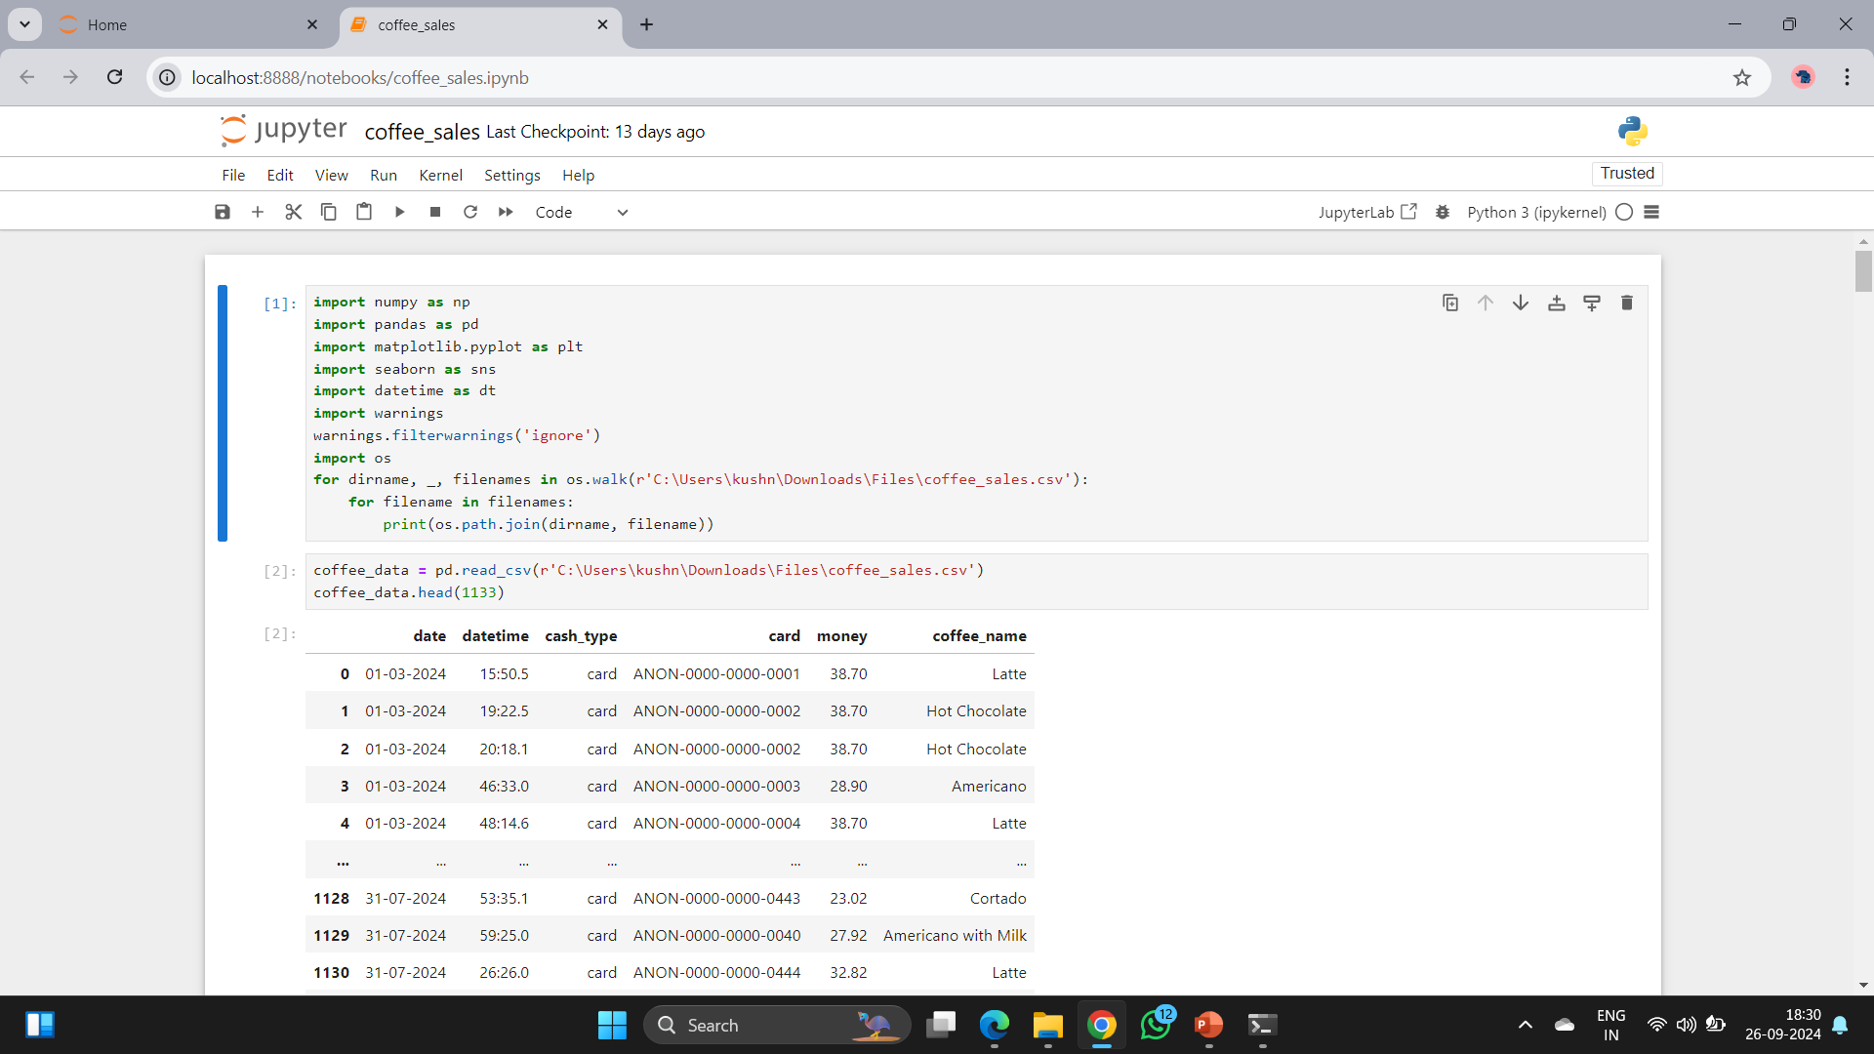
Import packages

Slide 7
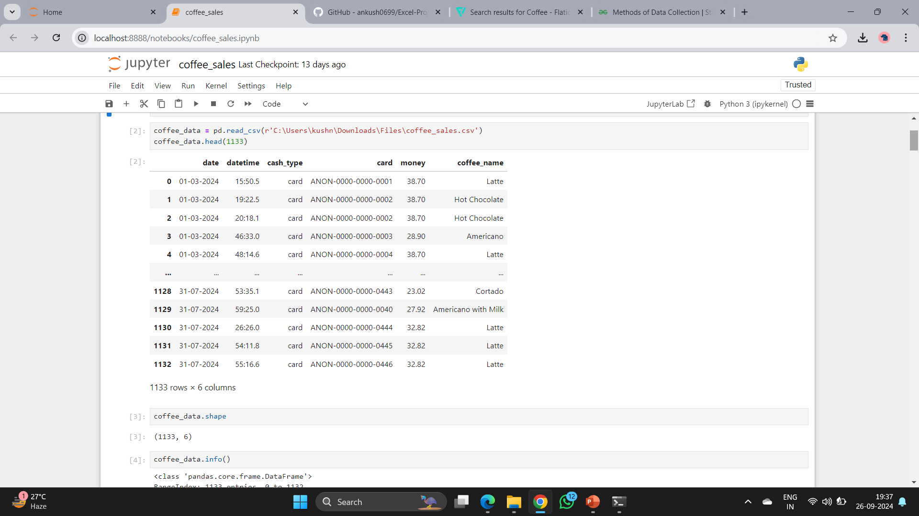
Load Data

Slide 8
Conducted exploratory data analysis (EDA) to visualize sales trends:
This dataset contains detailed records of coffee sales from a vending machine.
The vending machine is the work of a dataset author who is committed to providing an open dataset to the community.
It is intended for analysis of purchasing patterns, sales trends, and customer preferences related to coffee products.

Slide 9
Prepared the data for machine learning by handling categorical variables and splitting the dataset:
Categorical variables were encoded using one-hot encoding (pd.get_dummies()), and
Split the data into training and test sets using train_test_split().

Slide 10
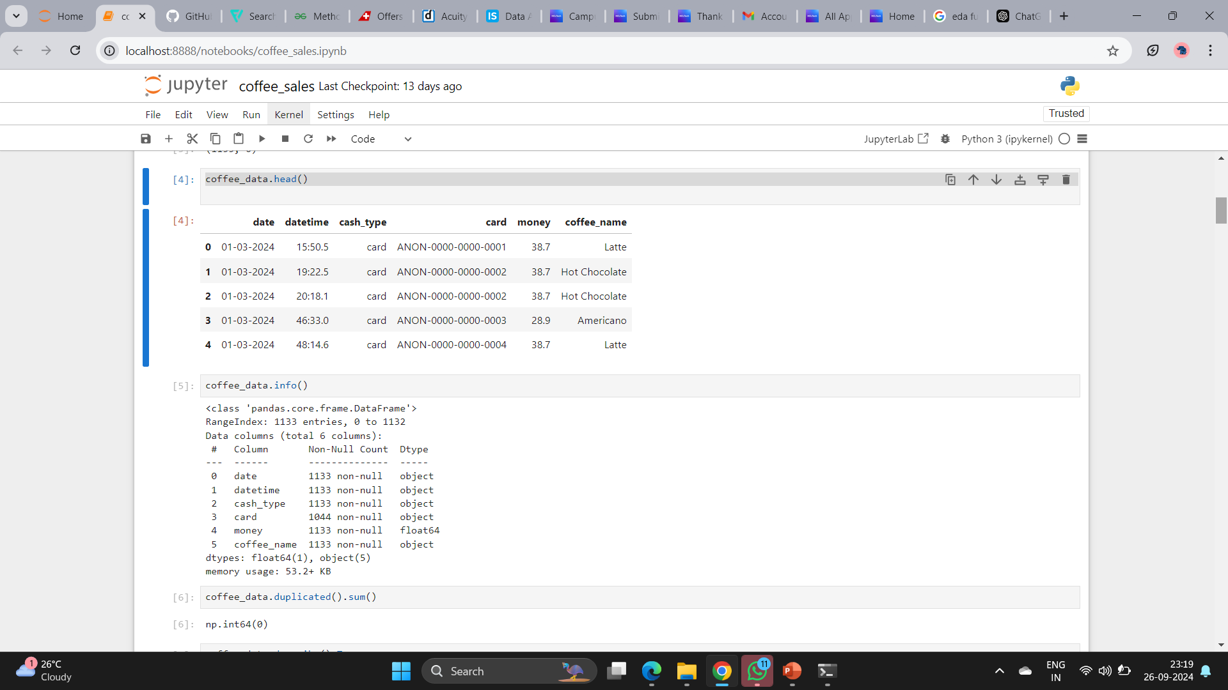
Exploratory Data Analysis (EDA)

Slide 11
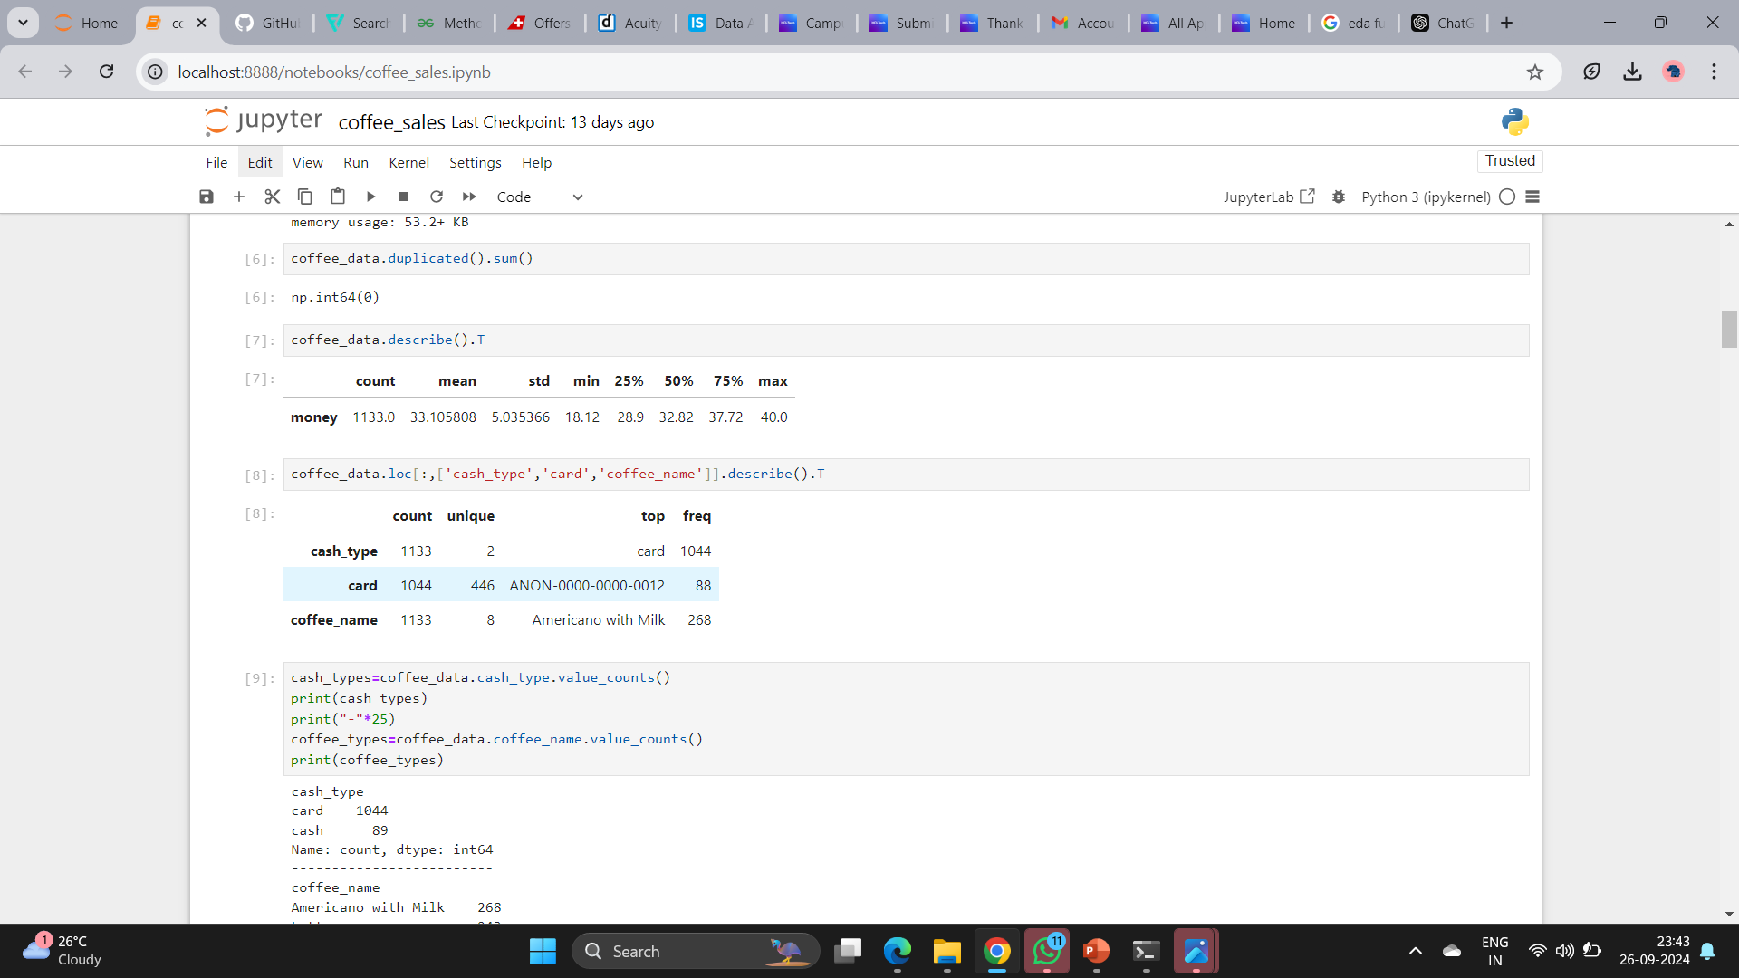
There are 1133 transactions in the data.
88 missing values in the column 'card’.
No duplicates.
2 unique values of 'cash_type’.
8 different coffee types with 'Americano with Milk' is the most popular product.

Slide 12
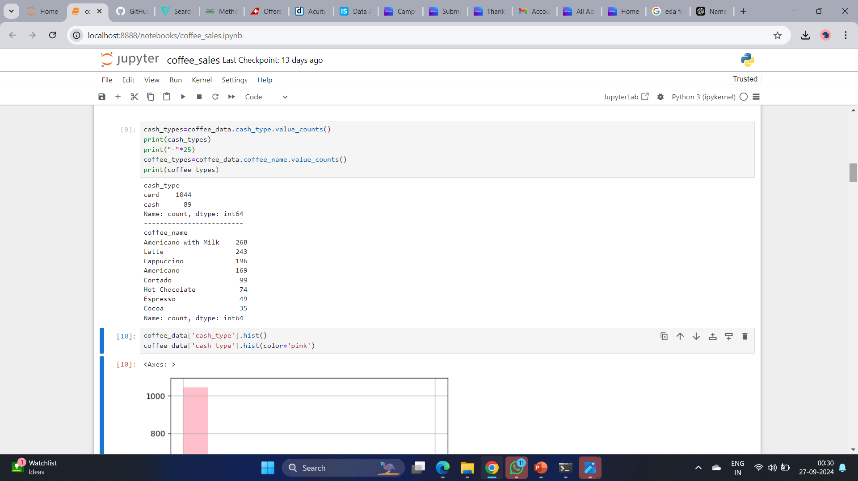

Slide 13
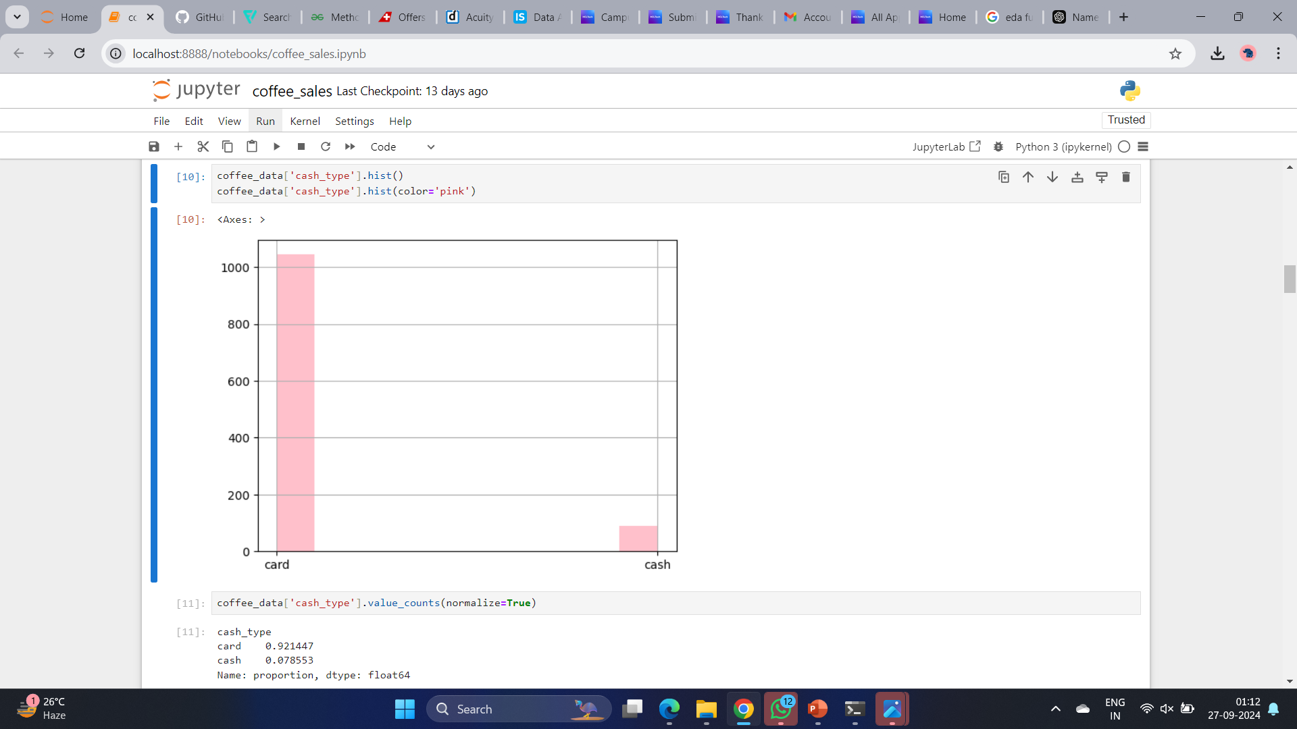
~92% of the transactions are from card users.

Slide 14
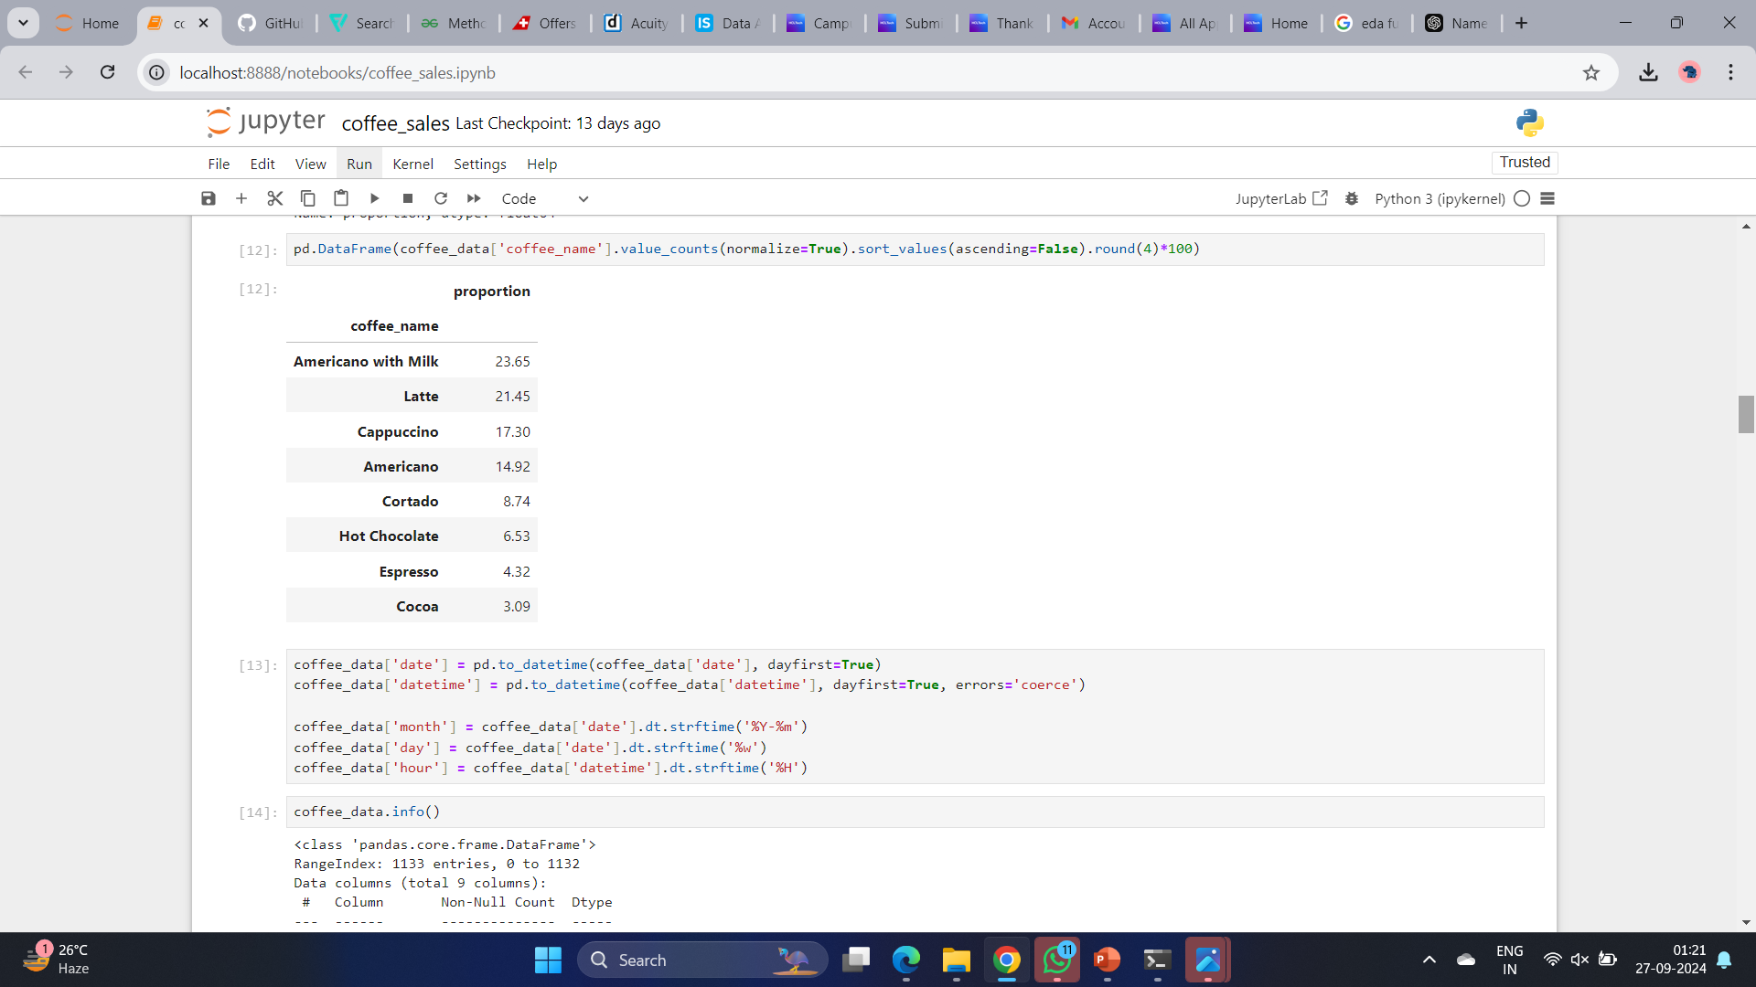
Americano with Milk and Latte are our most popular coffee products. In the second tier are Cappuccino and Americano, while Cortado, Hot Chocolate, Espresso, and Cocoa are less popular.

Slide 15
Trained a simple linear regression model to predict sales:
Built a Linear Regression model with LinearRegression() and
Trained it on the training set (model.fit()).

Slide 16
Evaluated the model's performance:
Evaluated the model's performance using Mean Squared Error (mean_squared_error) and R^2 score (r2_score), which are both standard metrics to assess a regression model's accuracy.

Slide 17
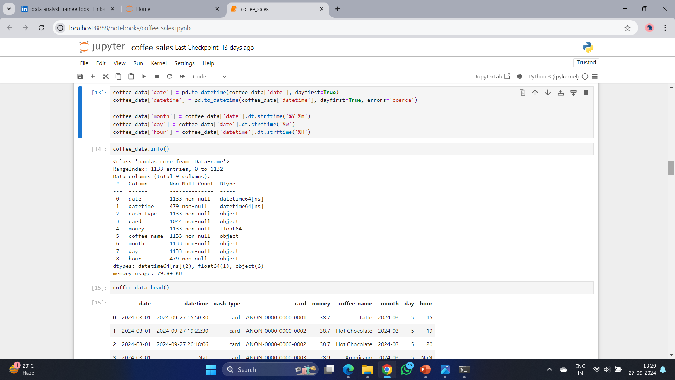
Next, let's conduct data transformations for further analysis.

Slide 18
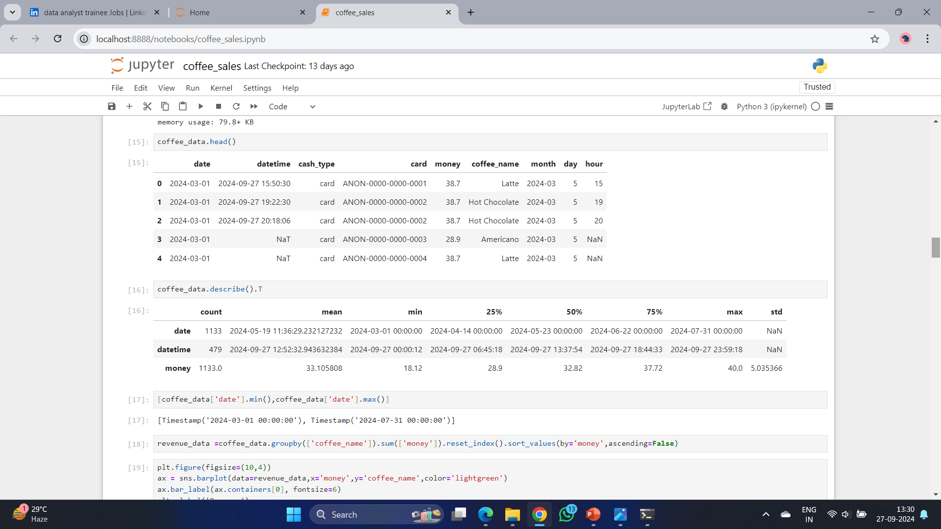
The time range of this data set is from 2023-3-1 to 2024-7-31

Slide 19
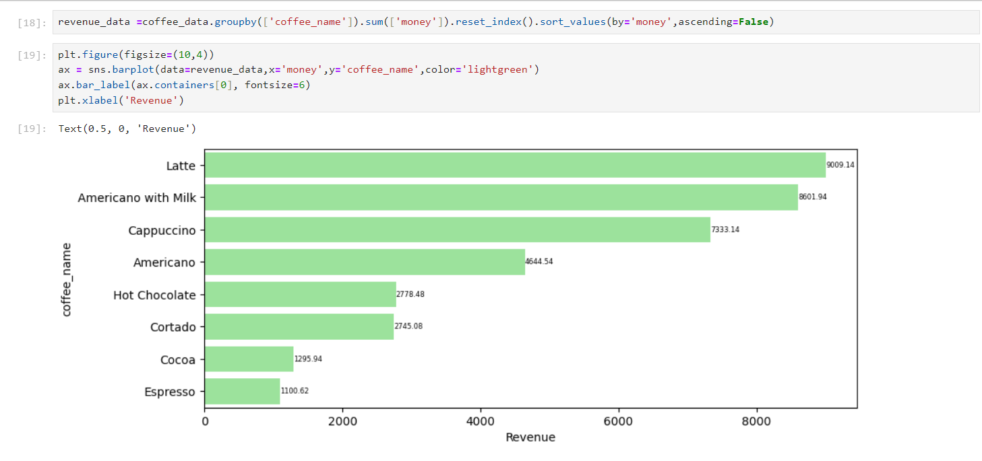
Let's first check the overall revenue by products.
Latte is the product with the highest revenue, while Expresso is the one at the bottom.

Slide 20
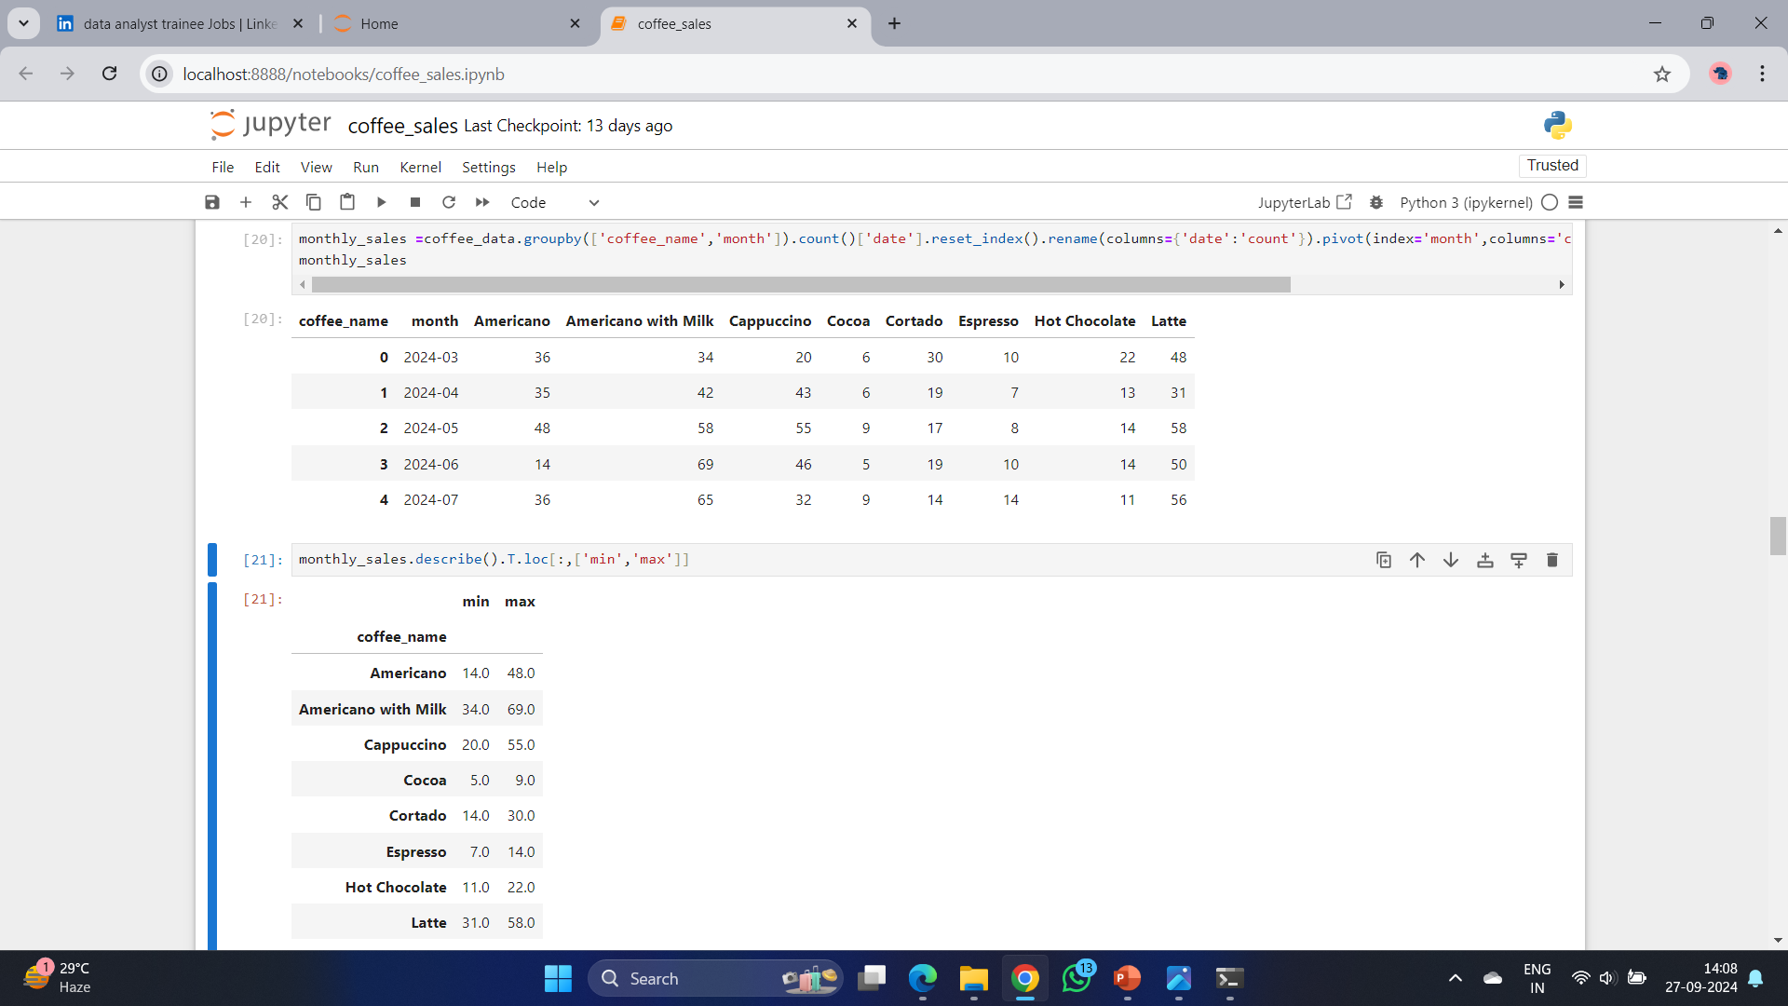
Then let's check the monthly data.

Slide 21
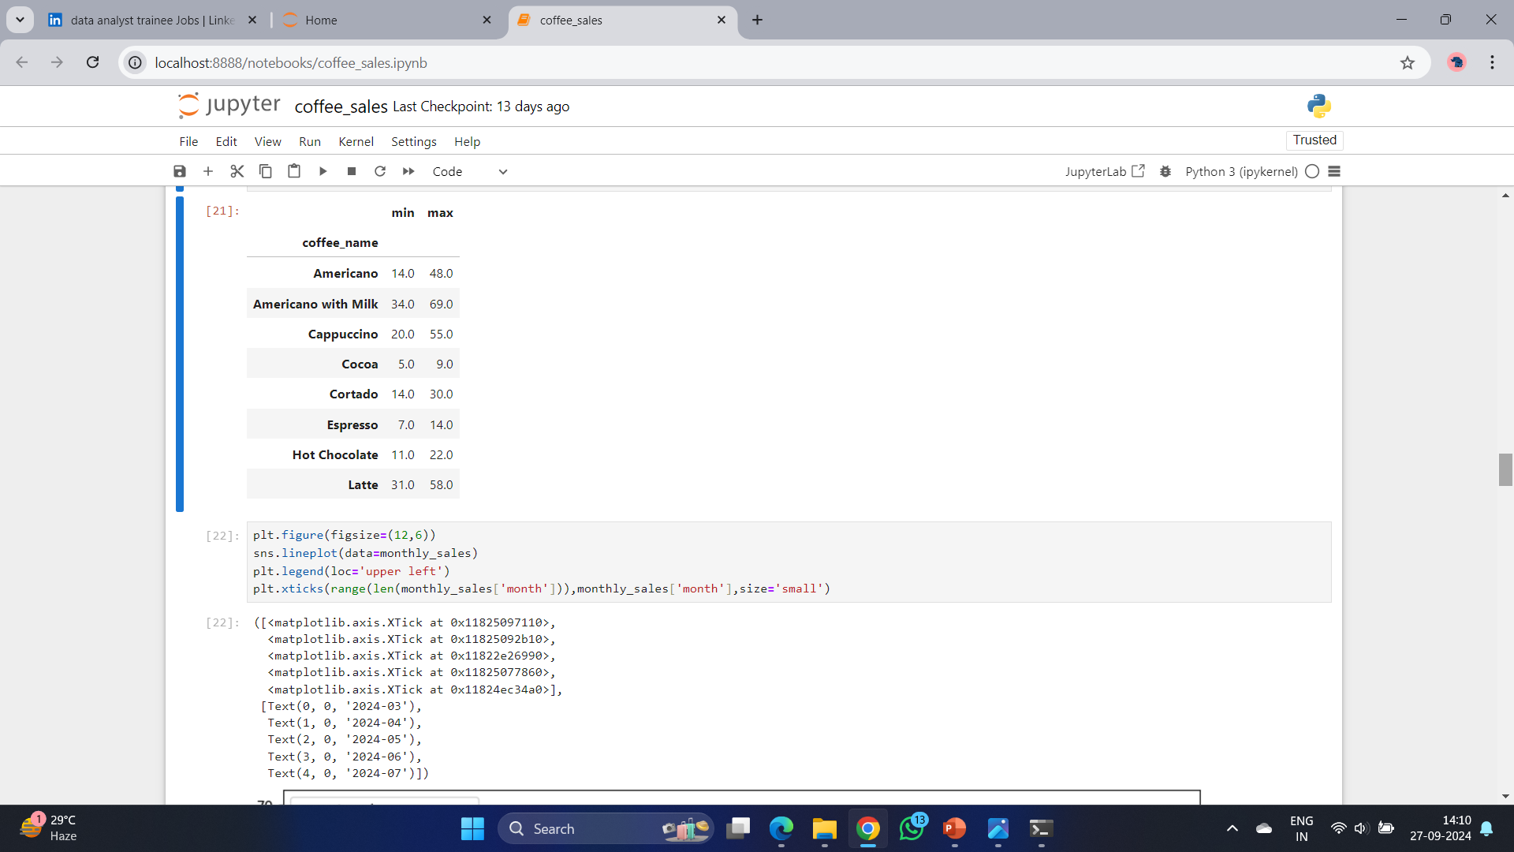

Slide 22
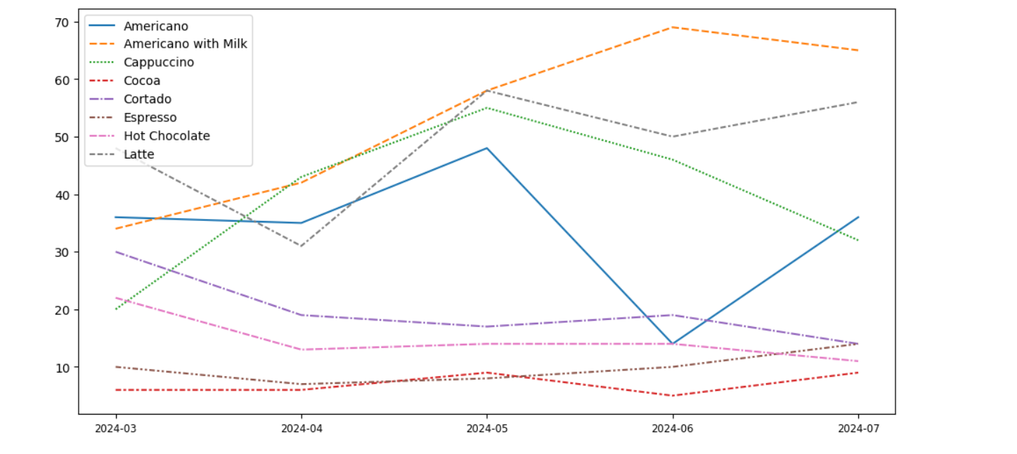
As shown in the line chart below,
Americano with Milk and Latte, and Cappuccino are top selling coffee types, while Cocoa and Expresso have lowest sales.
Additionally, Americano with Milk and Latte show an upward trending.

Slide 23
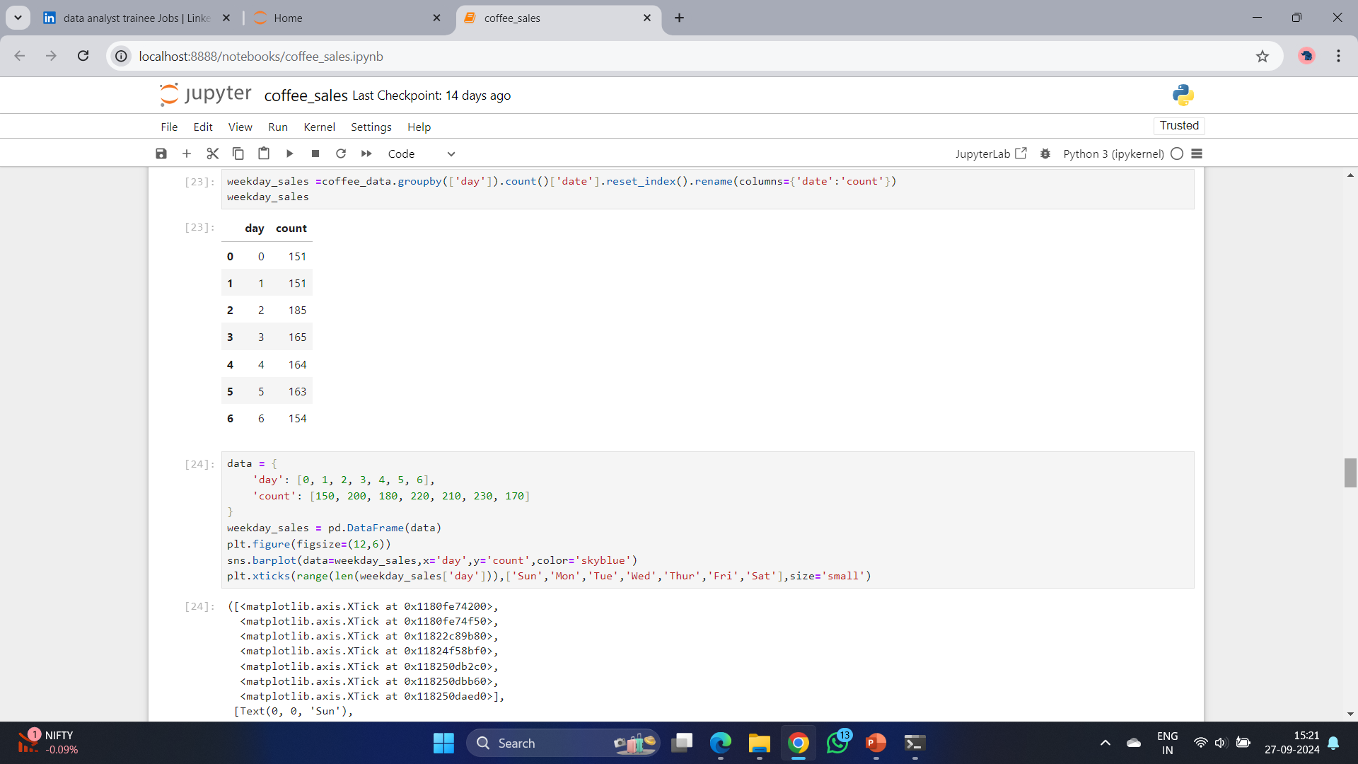

Slide 24
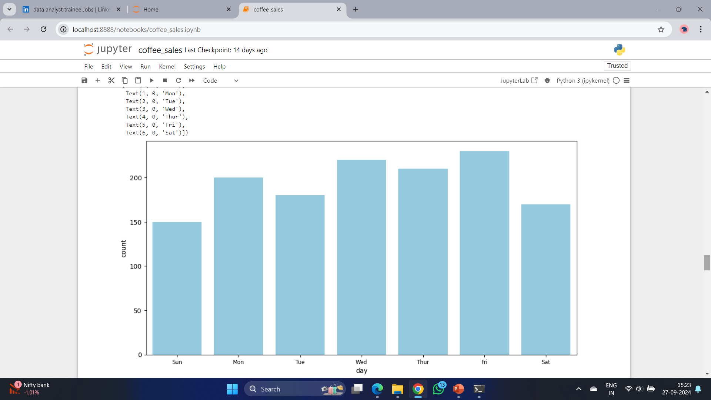
The bar chart reveals that Tuesday has the highest sales of the week, while sales on the other days are relatively similar.

Slide 25
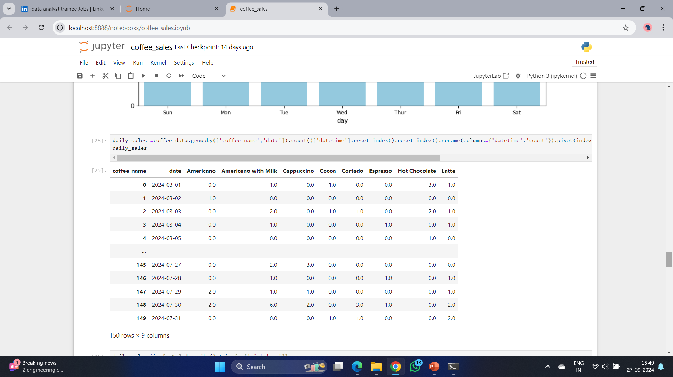

Slide 26
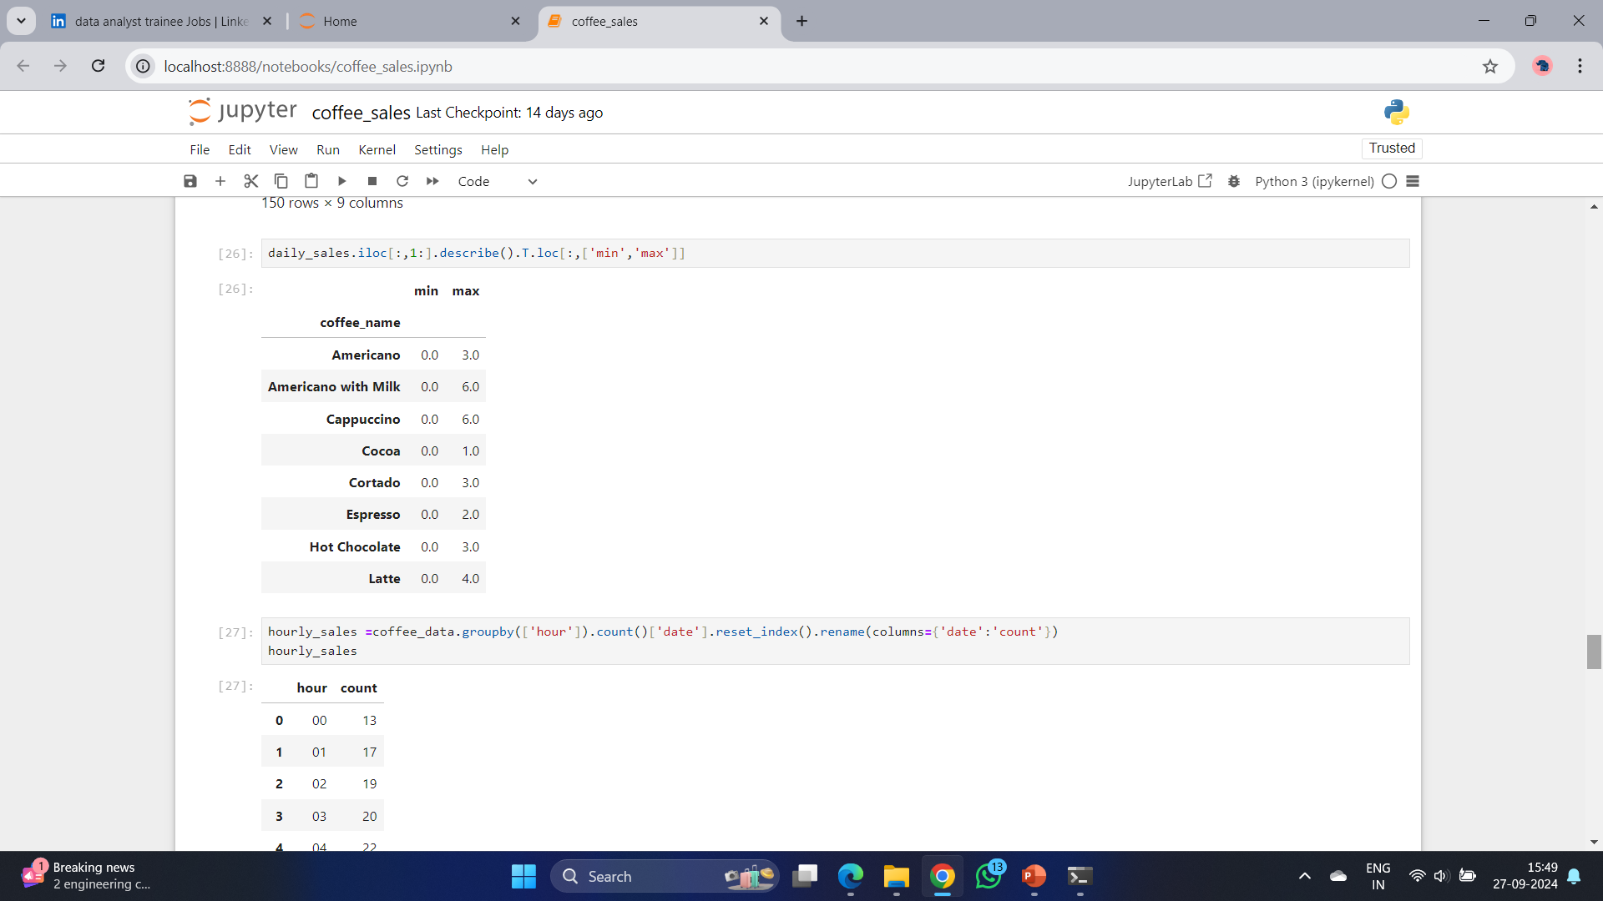
This table provides us the information of how many of each products can be sold in each day.

Slide 27
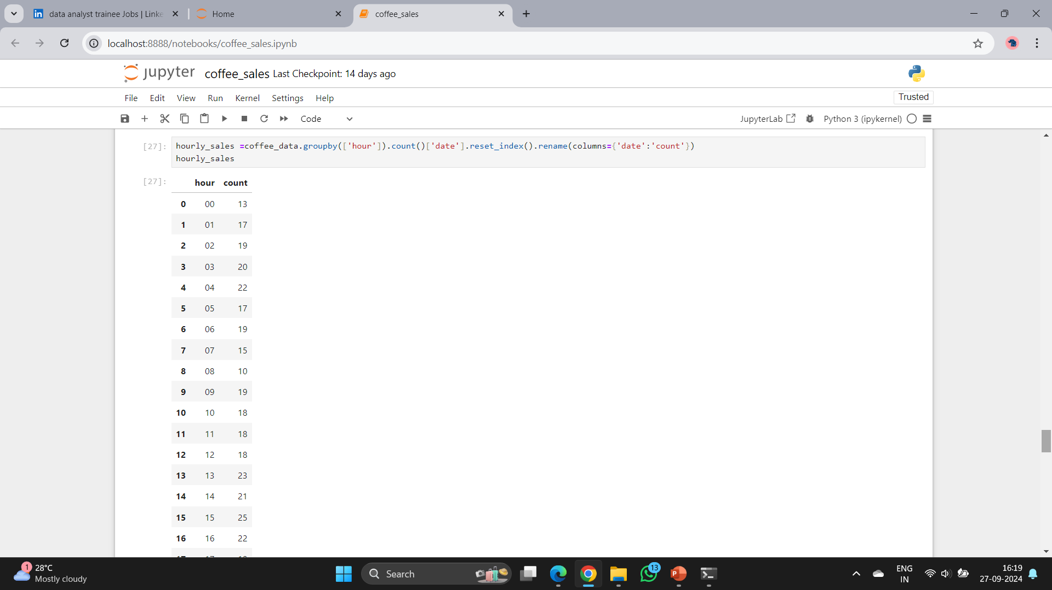
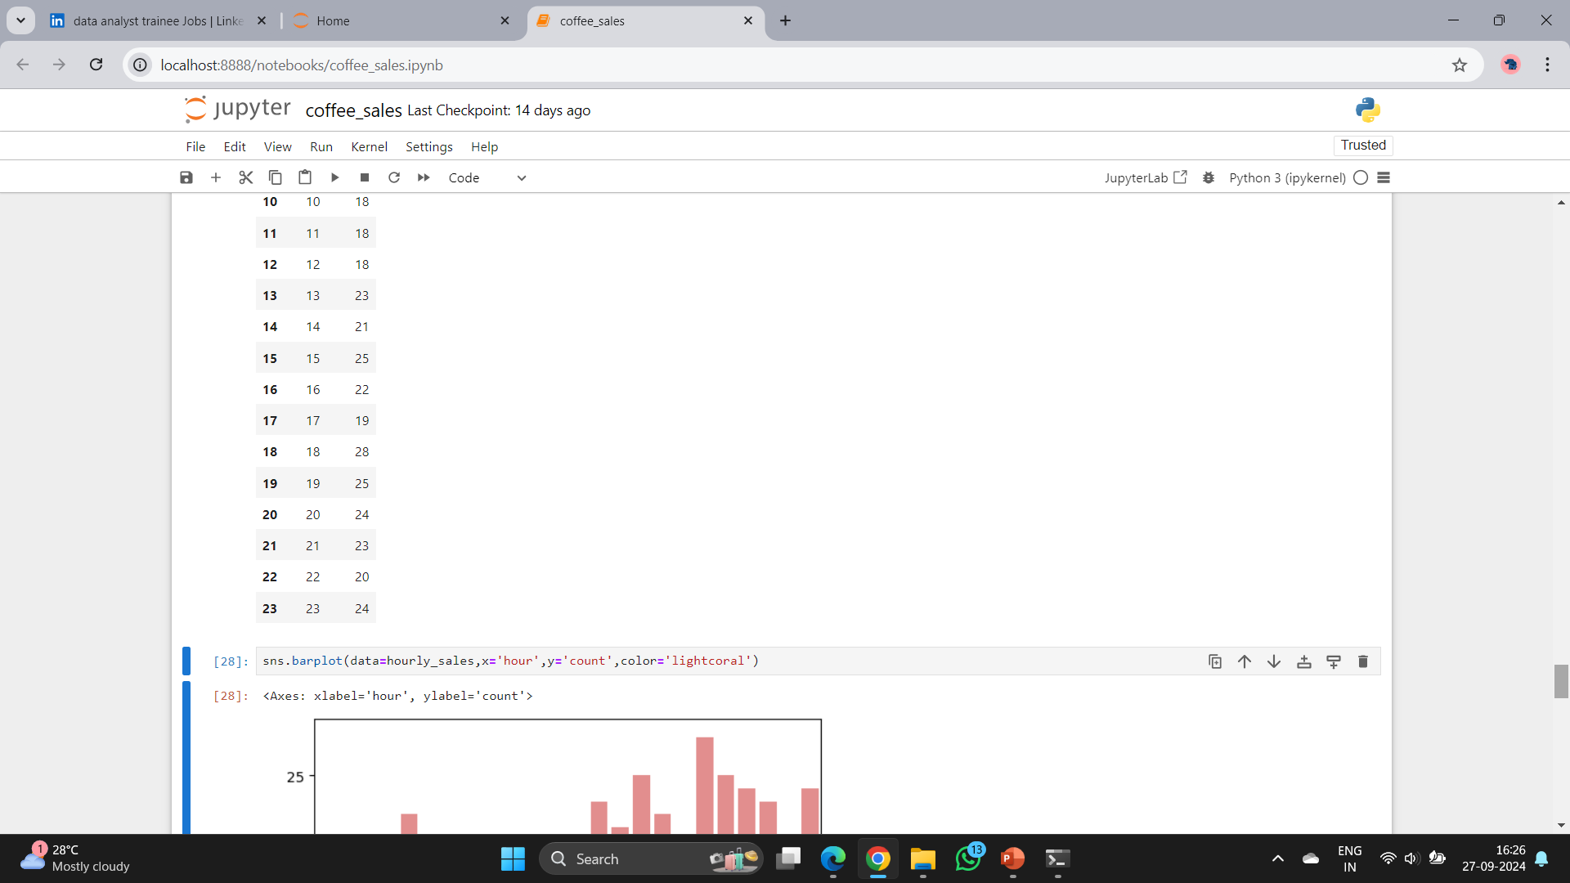

Slide 28
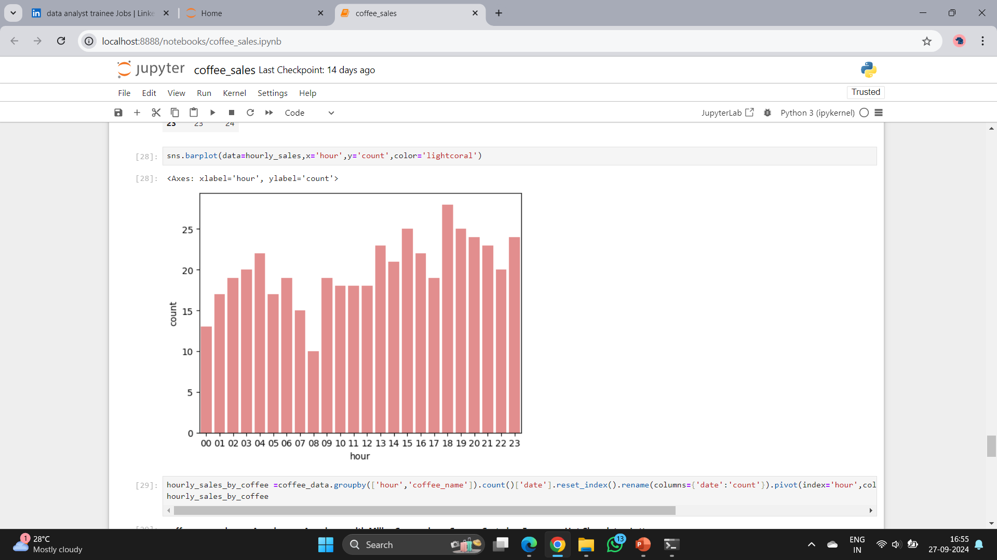
Overall, two peak hours within each day can be observed: 10:00am and 7:00pm. Then, let's check if any difference for different products.

Slide 29
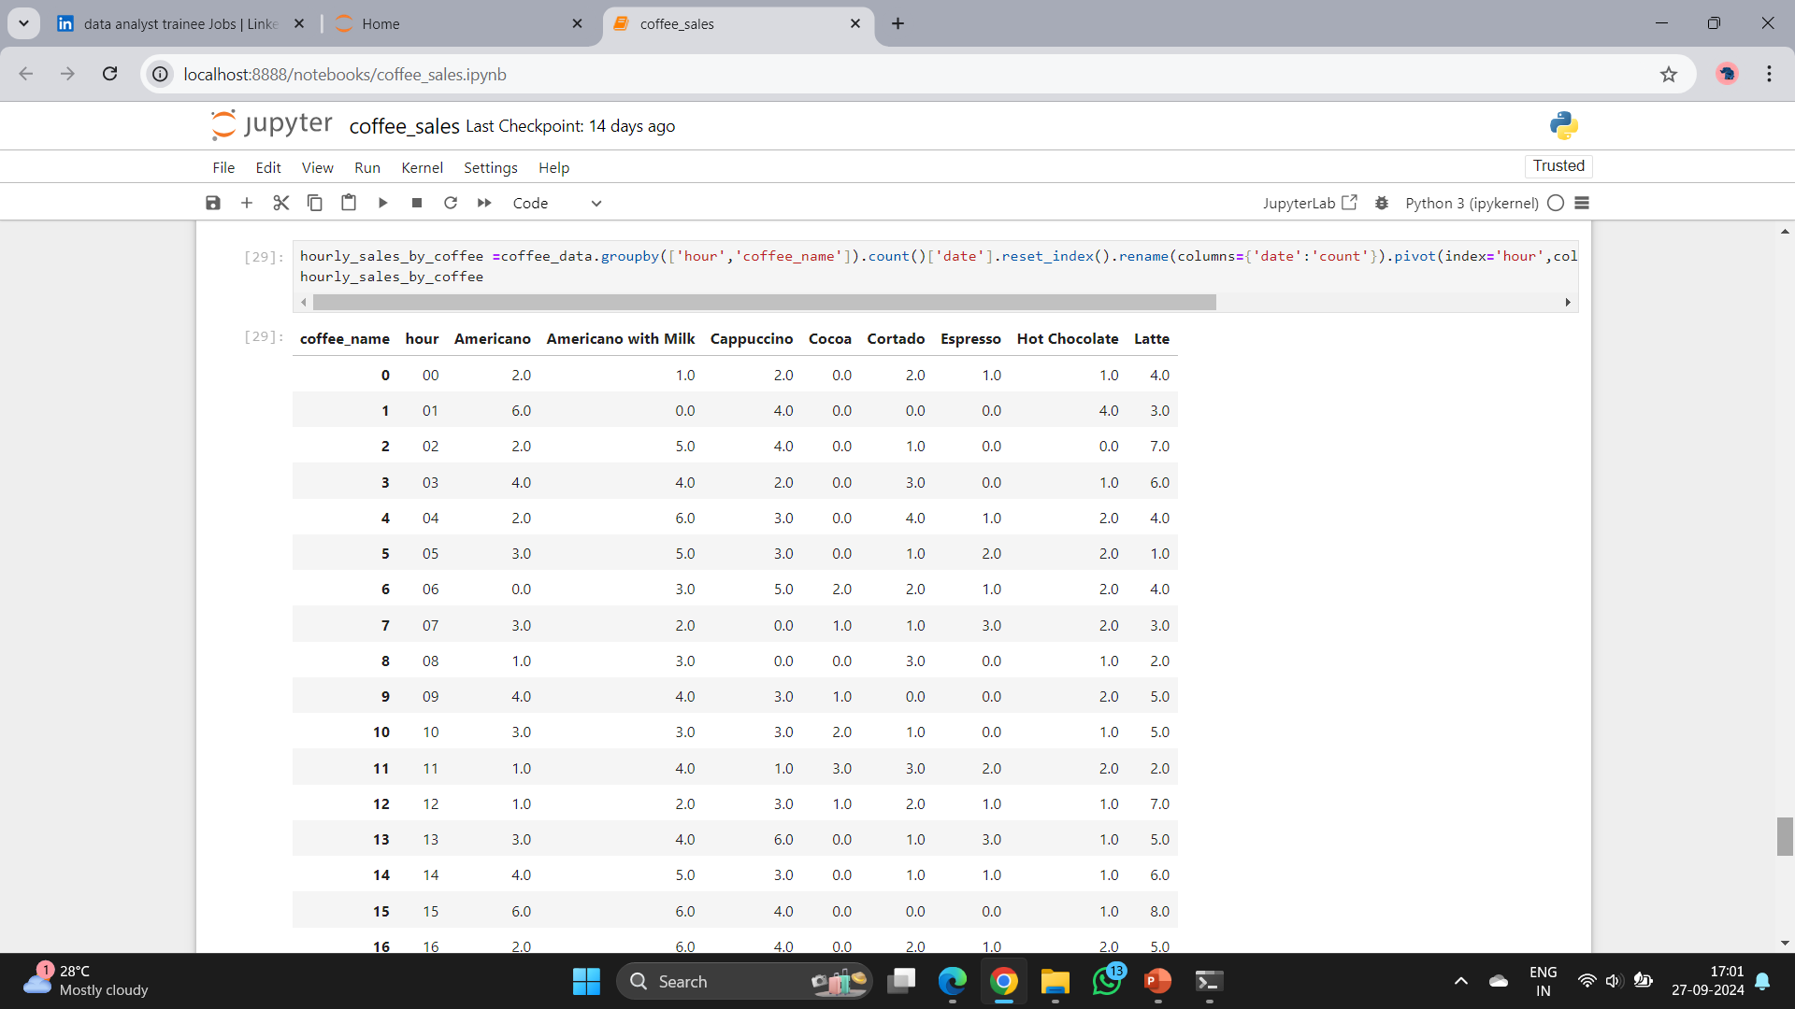

Slide 30
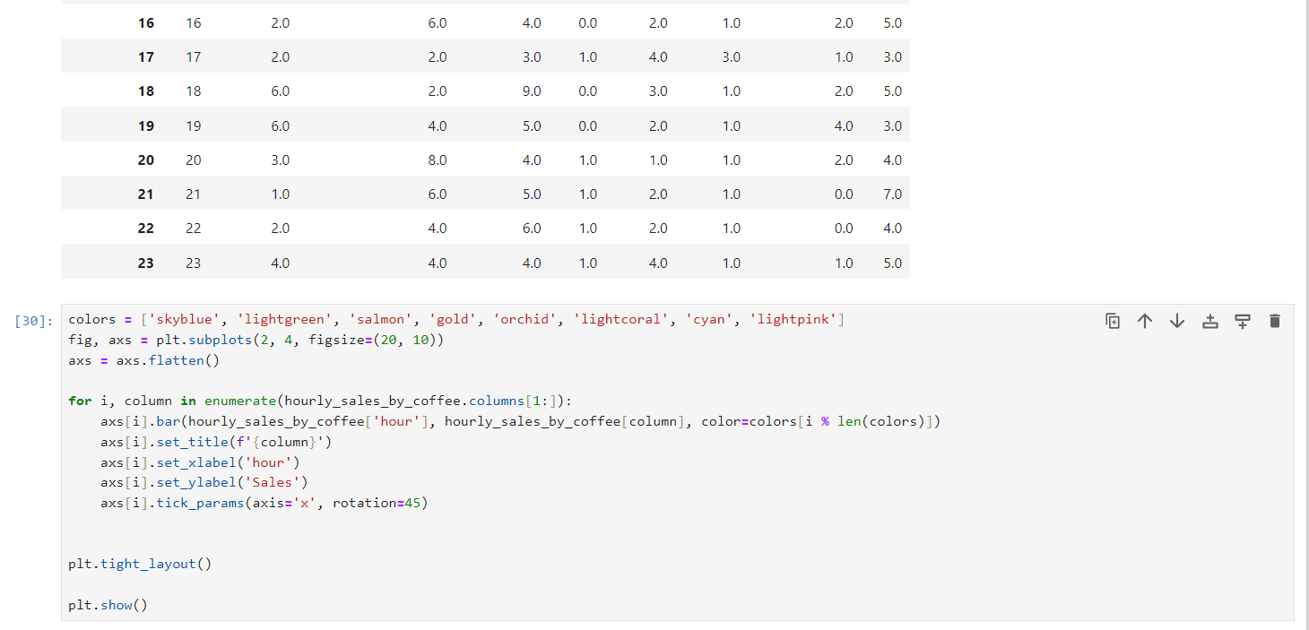

Slide 31
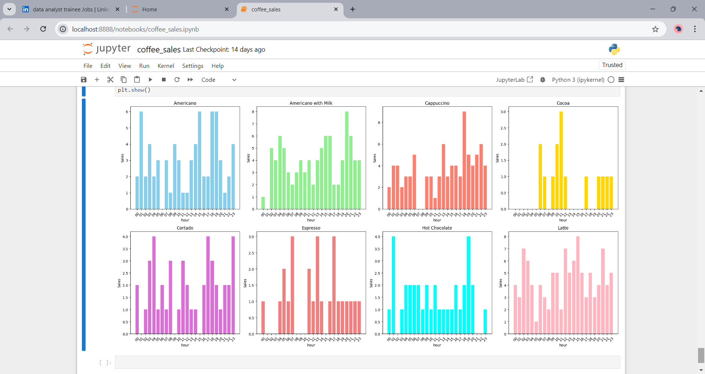
The plots above illustrate the shopping traffic for each product throughout the day. Notably, all products experience a peak in traffic around 10:00 AM, with this trend being particularly pronounced for Latte. Additionally, Cappuccino, Cocoa, and Hot Chocolate tend to be more popular during the evening hours, specifically between 6:00pm and 8:00pm.

Slide 32
Conclusion
From the analysis above, uncovered valuable insights into customer shopping patterns on a daily and weekly basis.
Have identified the most popular coffee products and observed the shopping trends over time.
These findings are instrumental in optimizing inventory planning, designing the

Slide 33
THANK YOU

